Slide 1




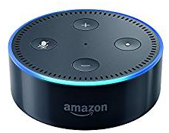








Front-end
https
https
https
Back-end
http
https
EC2
Elastic Load Balancer
S3

Slide 2

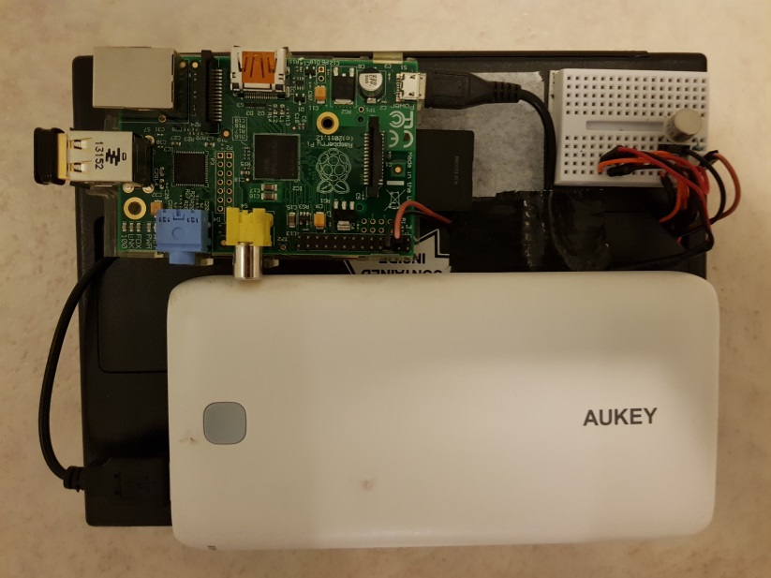


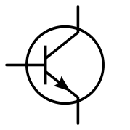
Physical notifier
Lightbox
switch
Lightbox
Lamp
Rechargeable USB
Battery pack
2K
AAAs in lightbox’s
battery compartment
3

Slide 3
Vue.js App
If “Butler” user
Login.vue
DrinkList.vue
Butler.vue
DrinkDetails.vue
DrinkEditDetails.vue
Butler Only

